Slide 1
Micro Credit Loan Defaulter Project Presentation
Submitted By | Ankit Dadarwala | Data Science Intern at Flip Robo Technologies

Slide 2

Introduction
Problem Statement:
A Microfinance Institution (MFI) is an organization that offers financial services to low income populations. MFS becomes very useful when targeting especially the unbanked poor families living in remote areas with not much sources of income. The Microfinance services (MFS) provided by MFI are Group Loans, Agricultural Loans, Individual Business Loans and so on. Many microfinance institutions (MFI), experts and donors are supporting the idea of using mobile financial services (MFS) which they feel are more convenient and efficient, and cost saving, than the traditional high-touch model used since long for the purpose of delivering microfinance services. Though, the MFI industry is primarily focusing on low income families and are very useful in such areas, the implementation of MFS has been uneven with both significant challenges and successes.

Slide 3
Introduction
Today, microfinance is widely accepted as a poverty-reduction tool, representing $70 billion in outstanding loans and a global outreach of 200 million clients. We are working with one such client that is in Telecom Industry. They are a fixed wireless telecommunications network provider. They have launched various products and have developed its business and organization based on the budget operator model, offering better products at Lower Prices to all value conscious customers through a strategy of disruptive innovation that focuses on the subscriber. They understand the importance of communication and how it affects a person’s life, thus, focusing on providing their services and products to low income families and poor customers that can help them in the need of hour. They are collaborating with an MFI to provide micro-credit on mobile balances to be paid back in 5 days. The Consumer is believed to be defaulter if he deviates from the path of paying back the loaned amount within the time duration of 5 days. For the loan amount of 5 (in Indonesian Rupiah), payback amount should be 6 (in Indonesian Rupiah), while, for the loan amount of 10 (in Indonesian Rupiah), the payback amount should be 12 (in Indonesian Rupiah).

Slide 4

Exercise
Build a model which can be used to predict in terms of a probability for each loan transaction, whether the customer will be paying back the loaned amount within 5 days of insurance of loan.
In this case, Label ‘1’ indicates that the loan has been paid i.e. Non- defaulter, while, Label ‘0’ indicates that the loan has not been paid i.e. defaulter.

Slide 5
Points to remember
There are no null values in the dataset.
There may be some customers with no loan history.
The dataset is imbalanced. Label ‘1’ has approximately 87.5 percent records, while, label ‘0’ has approximately 12.5 percent records.
For some features, there may be values which might not be realistic. You may have to observe them and treat them with a suitable explanation.
You might come across outliers in some features which you need to handle as per your understanding. Keep in mind that data is expensive and we cannot lose more than 7-8 percent of the total data.

Slide 6
Project Goals
Analytical Problem Framing
Exploratory Data Analysis (EDA)
Visualizations
Data Pre-Processing on train and test datasets
Model/s Development and Evaluation
Performing hyper parameter tuning, saving the best model and predicting the label
Conclusion and future work discussion

Slide 7
Data Description
label : Flag indicating whether the user paid back the credit amount within 5 days of issuing the loan {1:success, 0:failure}
msisdn : Mobile number of user
aon : Age on cellular network in days
daily_decr30 : Daily amount spent from main account, averaged over last 30 days (in Indonesian Rupiah)
daily_decr90 : Daily amount spent from main account, averaged over last 90 days (in Indonesian Rupiah)
rental30 : Average main account balance over last 30 days
rental90 : Average main account balance over last 90 days
last_rech_date_ma : Number of days till last recharge of main account
last_rech_date_da : Number of days till last recharge of data account
last_rech_amt_ma : Amount of last recharge of main account (in Indonesian Rupiah)
cnt_ma_rech30 : Number of times main account got recharged in last 30 days
fr_ma_rech30 : Frequency of main account recharged in last 30 days

Slide 8
Data Description
sumamnt_ma_rech30 : Total amount of recharge in main account over last 30 days (in Indonesian Rupiah)
medianamnt_ma_rech30 : Median of amount of recharges done in main account over last 30 days at user level (in Indonesian Rupiah)
medianmarechprebal30 : Median of main account balance just before recharge in last 30 days at user level (in Indonesian Rupiah)
cnt_ma_rech90 : Number of times main account got recharged in last 90 days
fr_ma_rech90 : Frequency of main account recharged in last 90 days
sumamnt_ma_rech90 : Total amount of recharge in main account over last 90 days (in Indonesian Rupiah)
medianamnt_ma_rech90 : Median of amount of recharges done in main account over last 90 days at user level (in Indonesian Rupiah)
medianmarechprebal90 : Median of main account balance just before recharge in last 90 days at user level (in Indonesian Rupiah)
cnt_da_rech30 : Number of times data account got recharged in last 30 days
fr_da_rech30 : Frequency of data account recharged in last 30 days
cnt_da_rech90 : Number of times data account got recharged in last 90 days

Slide 9
Data Description
fr_da_rech90 : Frequency of data account recharged in last 90 days
cnt_loans30 : Number of loans taken by user in last 30 days
amnt_loans30 : Total amount of loans taken by user in last 30 days
maxamnt_loans30 : Maximum amount of loan taken by the user in last 30 days
medianamnt_loans30: Median of amounts of loan taken by the user in last 30 days
cnt_loans90 : Number of loans taken by user in last 90 days
amnt_loans90 : Total amount of loans taken by user in last 90 days
maxamnt_loans90 : Maximum amount of loan taken by the user in last 90 days
medianamnt_loans90: Median of amounts of loan taken by the user in last 90 days
payback30 : Average payback time in days over last 30 days
payback90 : Average payback time in days over last 90 days
pcircle : Telecom circle
pdate : Date

Slide 10
Exploratory Data Analysis
First I have imported the necessary libraries and loaded the entire dataset in our Jupyter Notebook and renamed the project file from untitled.
Then I checked the shape of our dataset and found that we have a total of 2,09,593 rows and 37 different columns.
We don’t have any null values or missing values present in our dataset.
By checking the data types I came to know that our data set consists of columns have float, integer and object data type values.
Shape : 2,09,593 rows and 37 columns
No null values present
No Duplicate record found
Datatypes of float, integer and object are in dataset

Slide 11
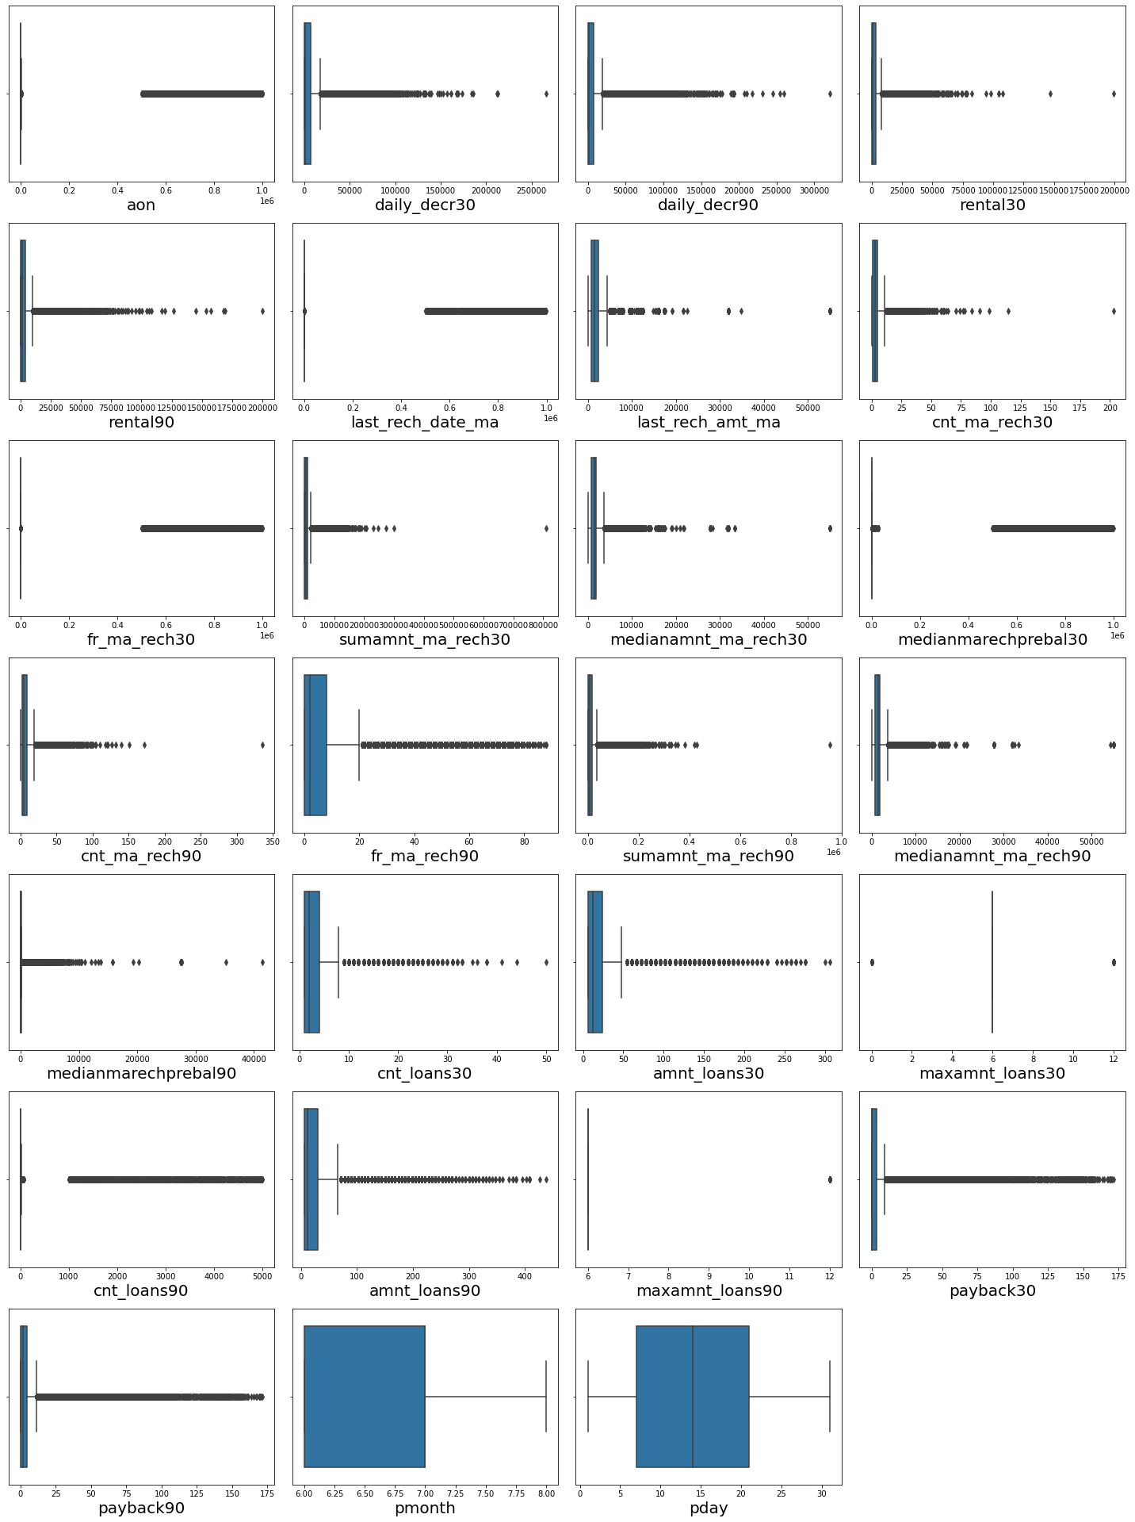
Describe
Here we see a statistical representation of the all the numeric data columns.
In that have outliers so treat them with different methods

Slide 12
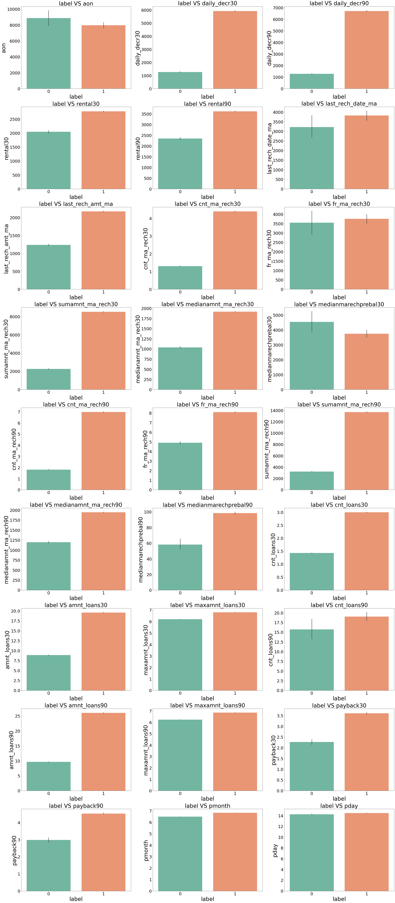
Bivariate Analysis
With the help of Bar Plot we are able to see the success and failure label data for the columns basically the feature data.

Slide 13
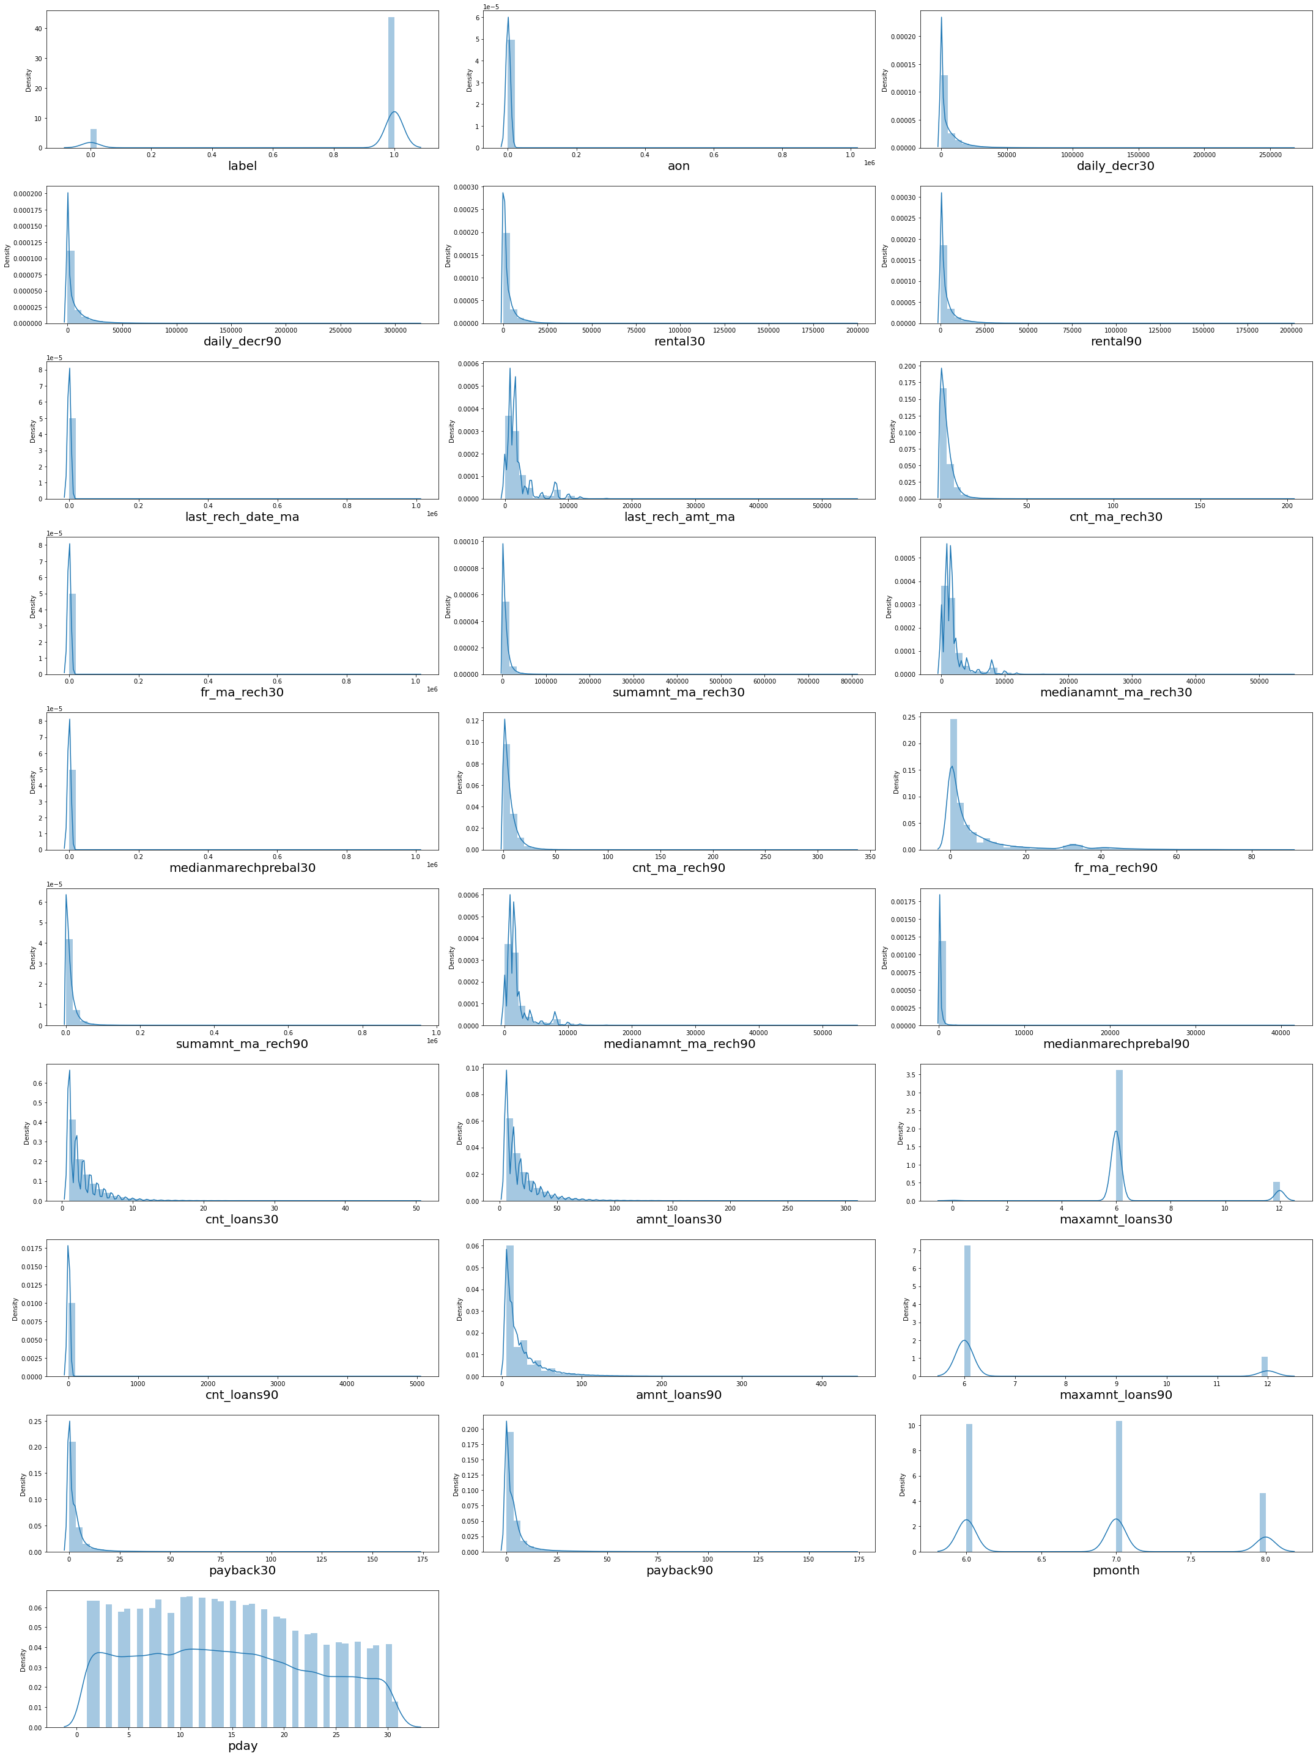
Multivariate Analysis
I used the Distribution plot to check through all the column details ensuring that the distribution is displayed for further analysis

Slide 14
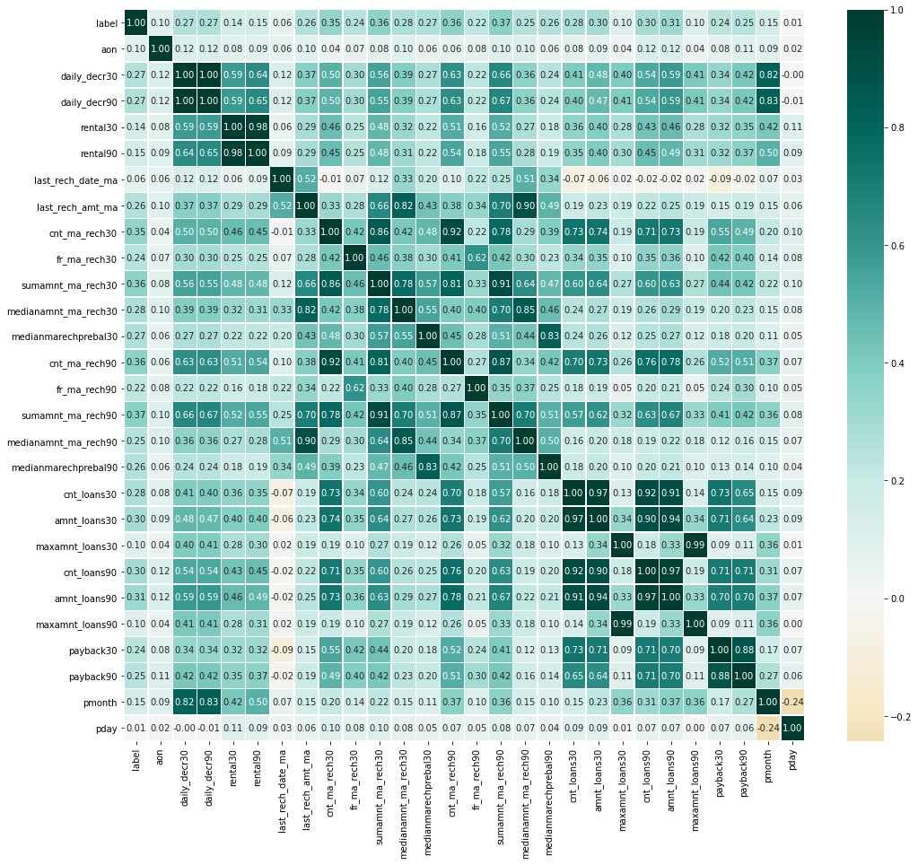
CORRELATION HEAT MAP
IN FIGURE SEE THAT TOO MANY COLUMNS ARE CORRELATED WITH EACH OTHER AND MULTI COLINEARITY RATIO IS HIGHT IN SUCH COLUMNS
WE HAVE TO REMOVE THAT COLUMNS FOR BETTER PREDITION

Slide 15
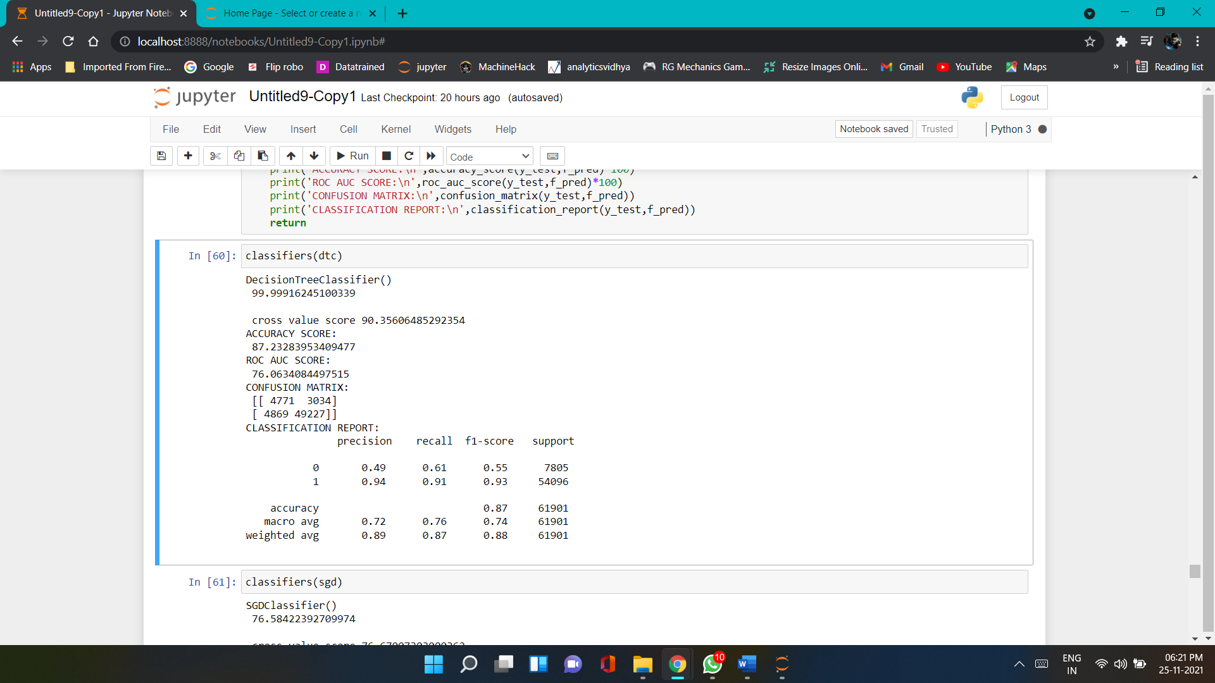
Run and evaluate select models
1). Decision Tree Classifier
I created this classification function to obtain the various input model details along with metric information on accuracy, cross validation, the classification report and the difference between accuracy and cross validation using 5 folds to avoid overfitting and underfitting concerns.

Slide 16
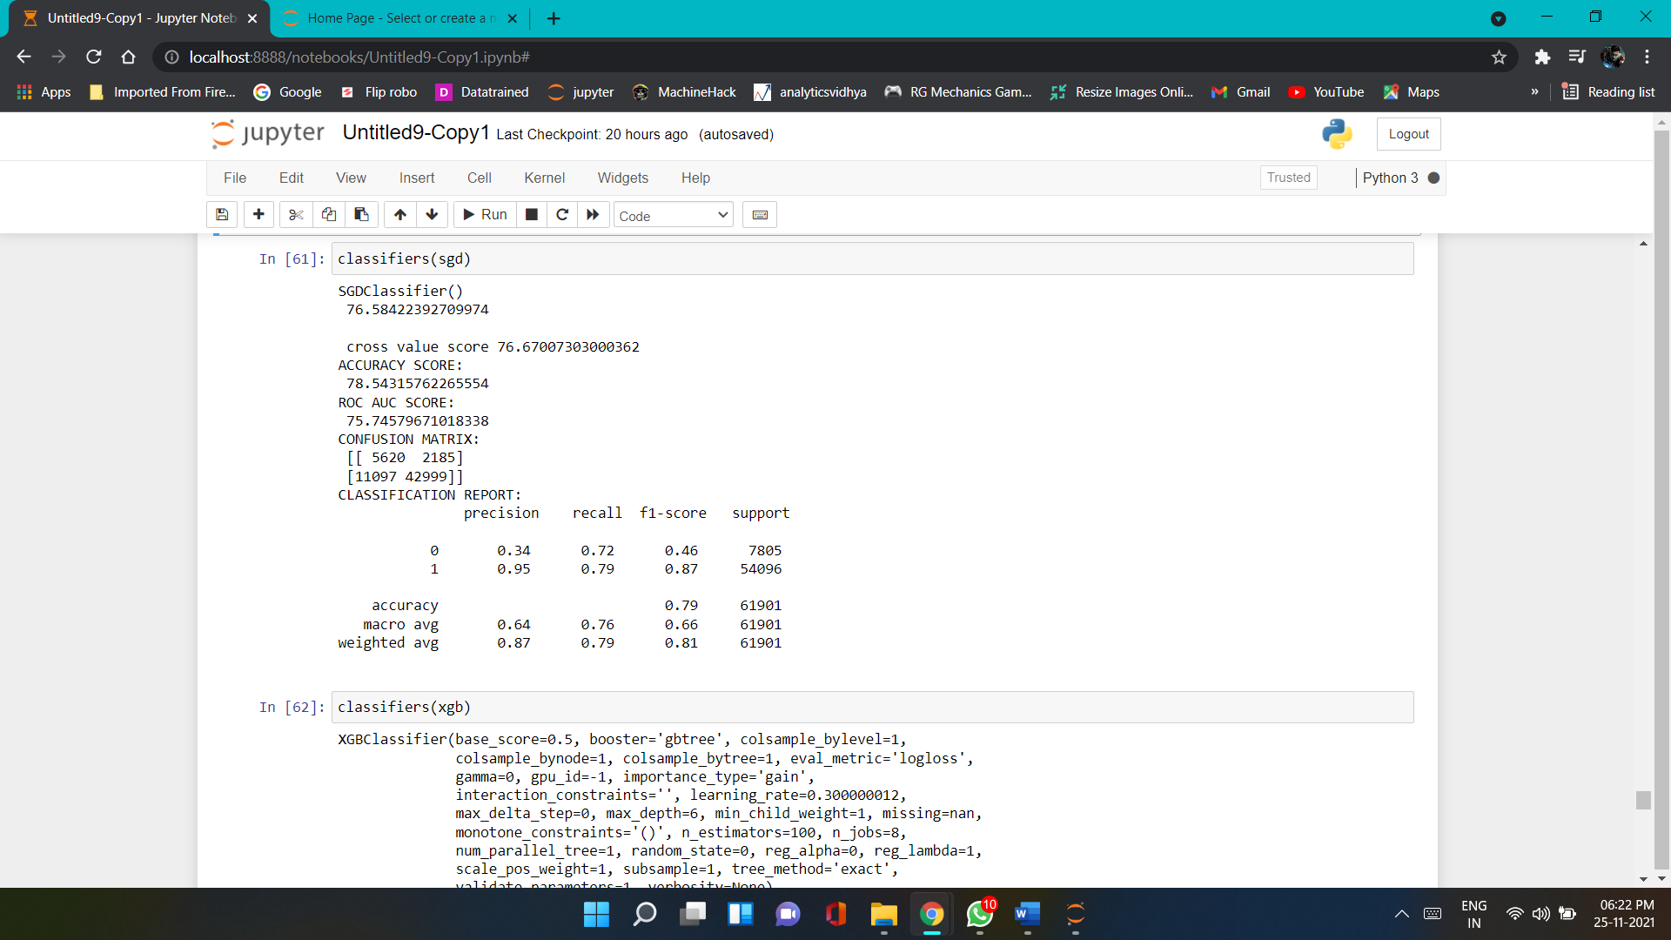
Run and evaluate select models
2).SGD Classifier

Slide 17
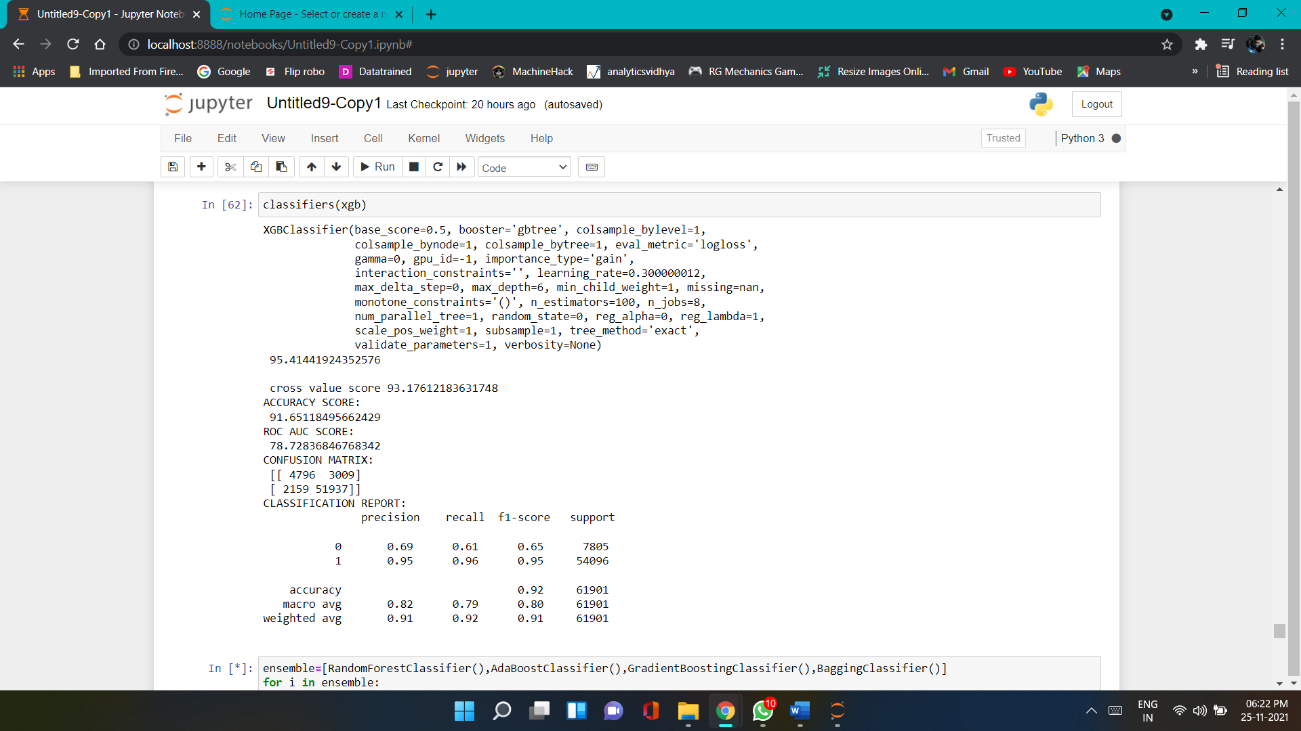
Run and evaluate select models
3). XGBoost Classifier

Slide 18
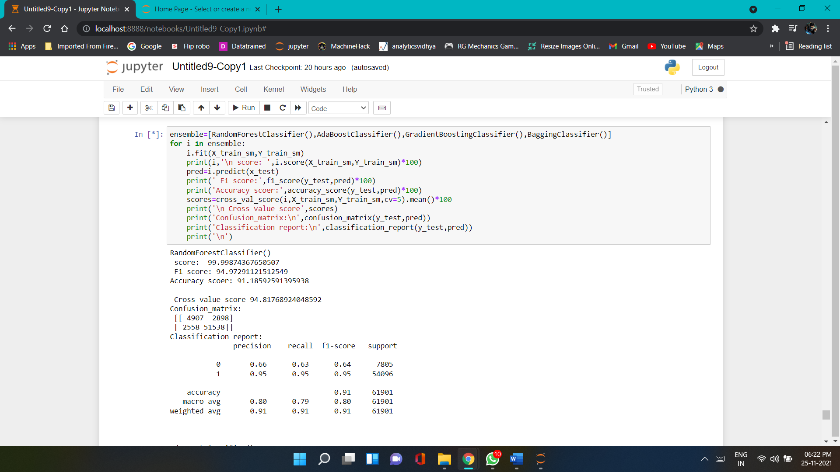
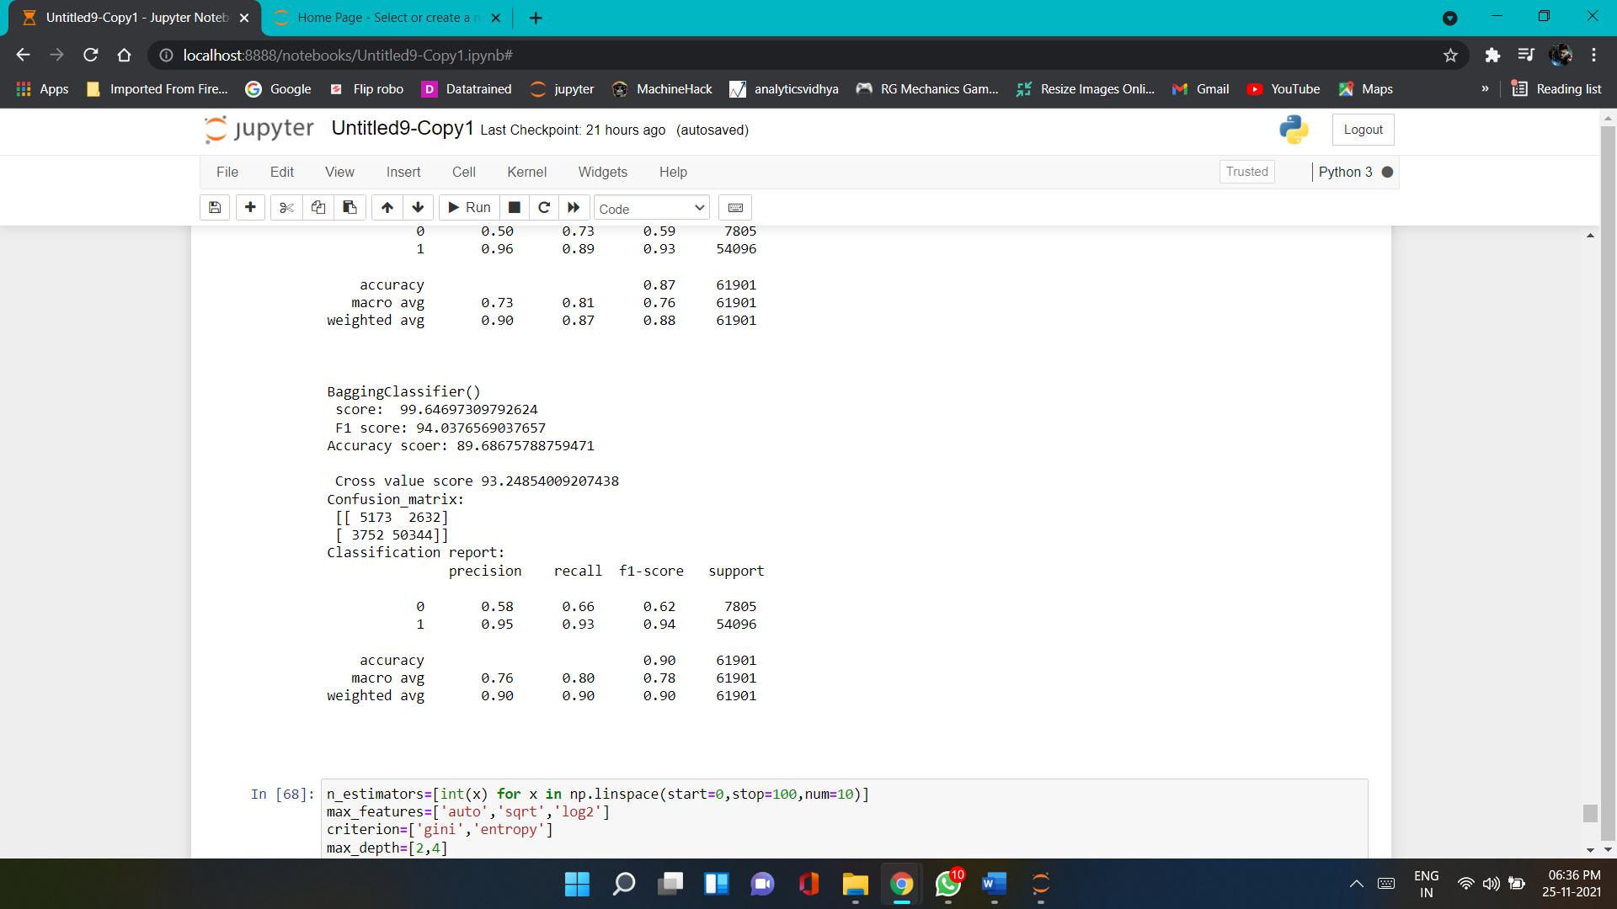
Run and evaluate select models
4). Random Forest Classifier
5). Bagging Classifier

Slide 19
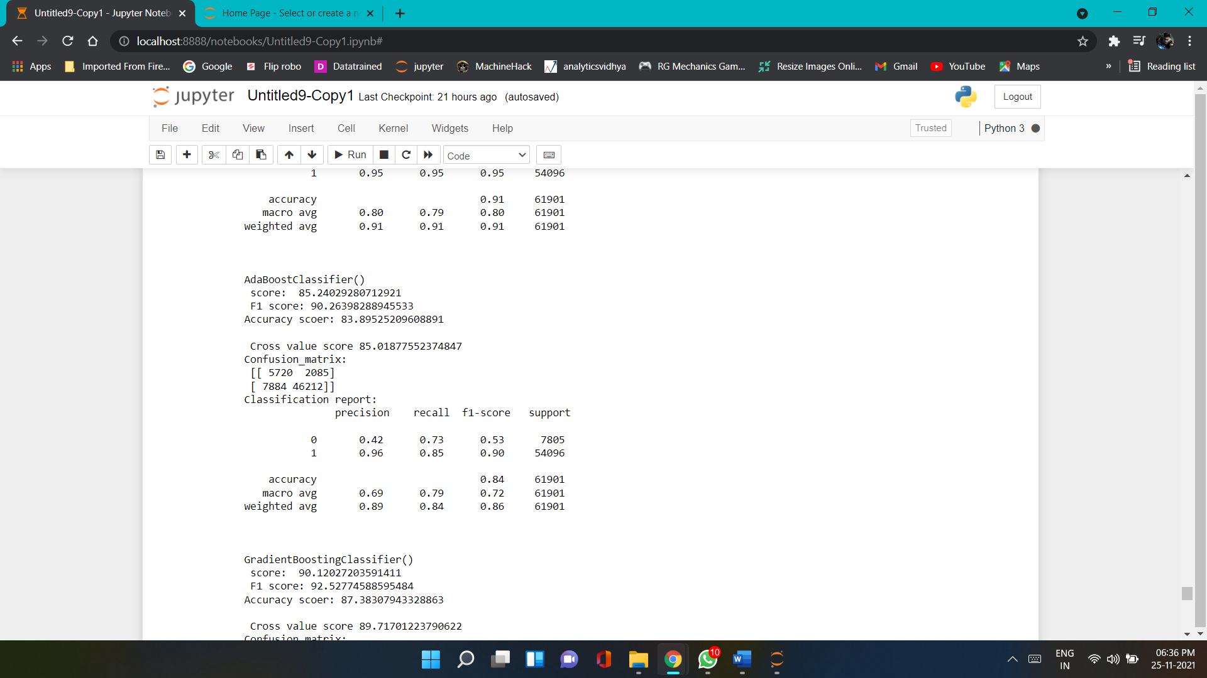
Run and evaluate select models
6).Ada Boost Classifier
7). Gradient Boosting Classifier

Slide 20
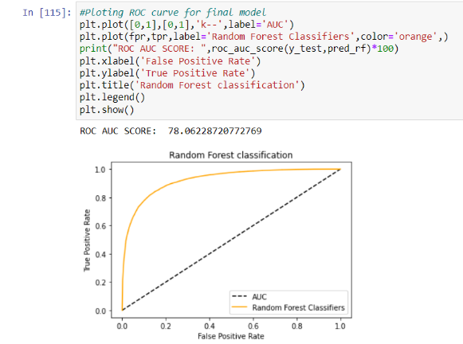
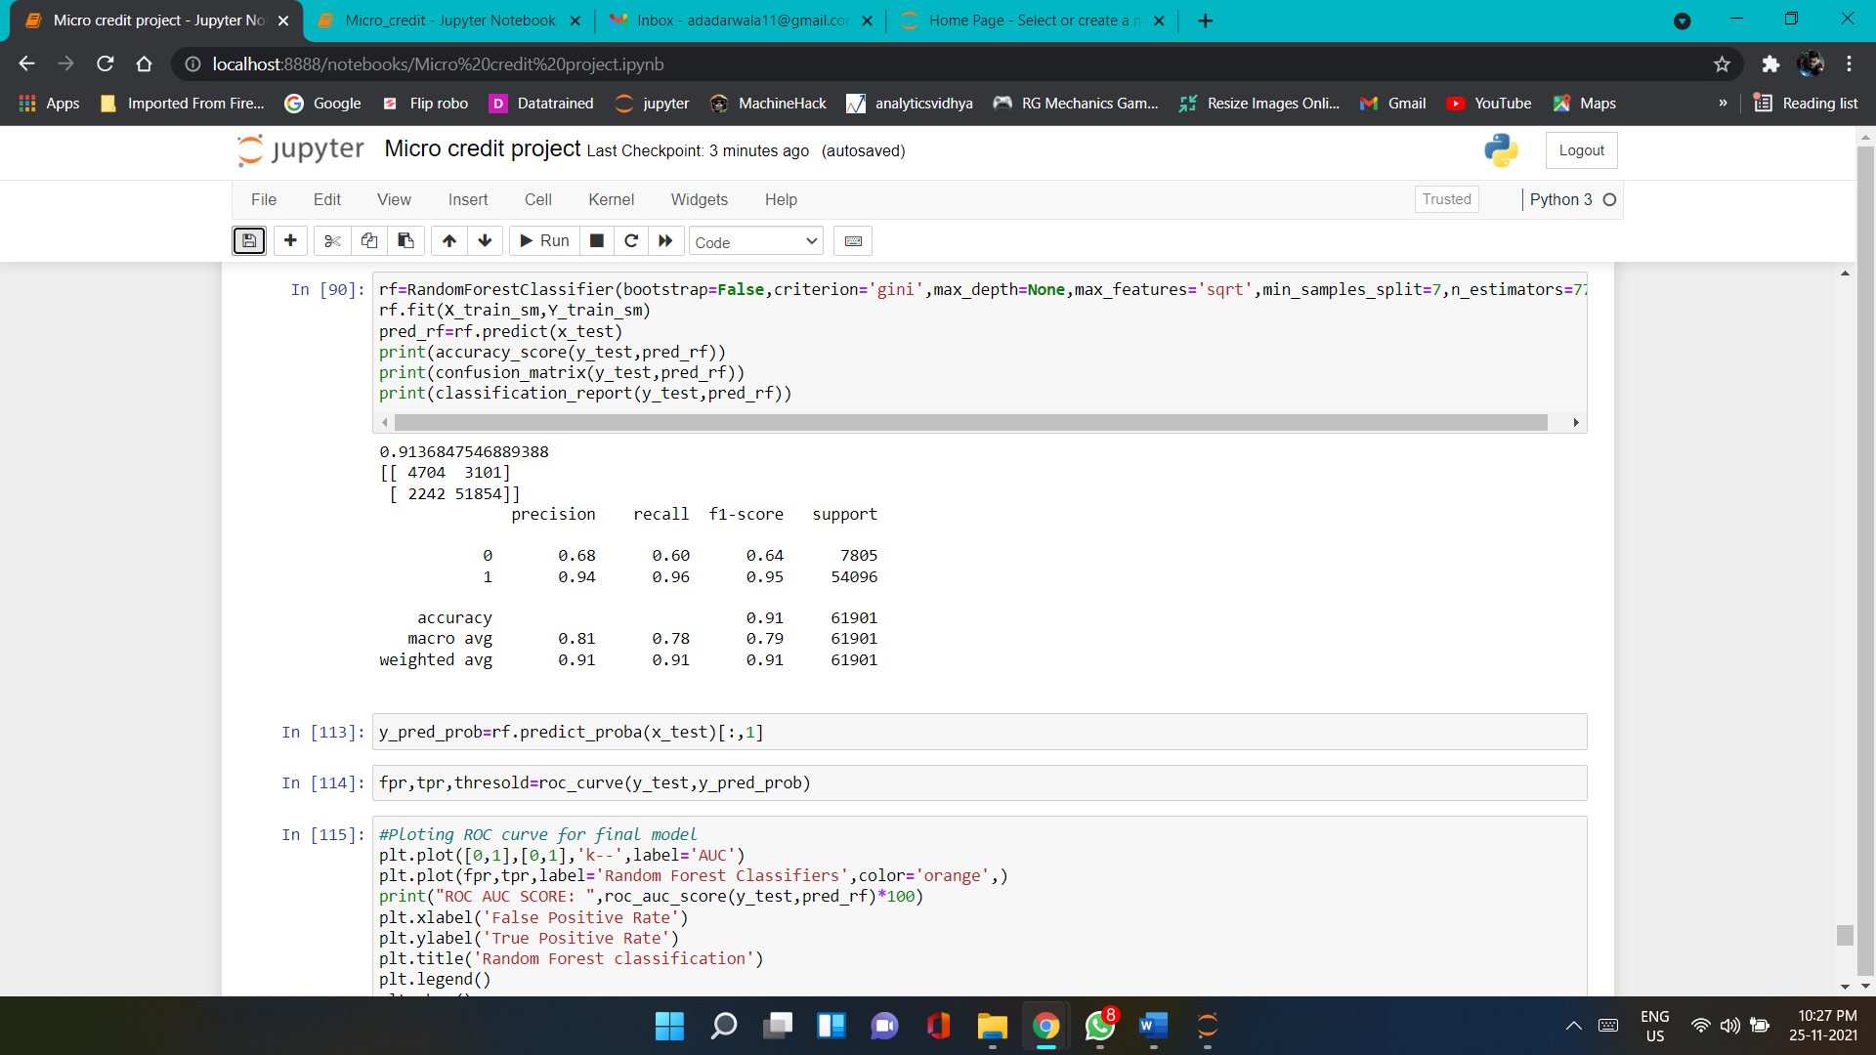
Hyper parameter tuning result

Slide 21
Conclusion
In this project report, we have used machine learning algorithms to predict the micro credit defaulters. We have mentioned the step by step procedure to analyze the dataset and finding the correlation between the features. Thus we can select the features which are correlated to each other and are independent in nature.
These feature set were then given as an input to four algorithms and a hyper parameter tunning was done to the best model and the accuracy has been improved. Hence we calculated the performance of each model using different performance metrics and compared them based on these metrics. Then we have also saved the best model and predicted the label. It was good the the predicted and actual values were almost same.

Slide 22
Limitations of this work and Scope for Future Work
First draw back is the length of the dataset it is very huge and hard to handle.
Followed by more number of outliers and skewness these two will reduce our model accuracy.
Also, we have tried best to deal with outliers, skewness and zero values. So it looks quite good that we have achieved a accuracy of 91.32% even after dealing all these drawbacks.
Also, this study will not cover all Classification algorithms instead, it is focused on the chosen algorithm, starting from the basic ensembling techniques to the advanced ones

Slide 23


